Slide 1





PRESENTATION 2026
AI-Driven Inventory Optimization & Demand-Supply Analysis Using Excel
Mentor Name
Student Name
Student Email
Uma Maheswari
Palak Kotwani
kotwanip065@gmail.com

Slide 2

Outline
Abstract of the Project
Problem Statement
Proposed Solution
System Architecture
Live Demo of the Project
Conclusion
Future Scope

Slide 3
Abstract
AI-Driven Inventory Optimization & Demand-Supply Analysis Using Excel — AICW Fellowship, Edunet Foundation in partnership with Microsoft, LinkedIn & SAP.
Analyzes 990 product records across 16 fields and 7 categories using Excel and AI tools to compute KPIs and surface inventory insights.
Tools: Microsoft Excel (pivot tables, IF/COUNTIF formulas, KPI sheet), Microsoft Copilot & ChatGPT for AI-assisted insights.
Key results: 53.4% orders pending; turnover rate 50.15; Bread Flour fastest (1,002 units); Lettuce slowest (166 units); Fruits & Vegetables leads with 19,361 sales units.

Slide 4

Problem Statement
53% of all orders (529/990) are pending — sales demand exceeds available stock.
Stock-demand mismatch causes delayed replenishment, missed sales and reactive decision-making.
Affects SMEs across 7 categories: Fruits & Vegetables, Dairy, Grains & Pulses, Seafood, Beverages, Oils & Fats, Bakery.
No accessible, unified Excel-based KPI model with AI integration exists for SME-level inventory datasets — a clear gap this project fills.
Dataset lacks demand forecasting, partial fulfilment tracking, and revenue/profit data — identified as future scope areas.

Slide 5

Proposed Solution
Five Excel modules built: Data Ingestion, Formula Validation, KPI Computation, Pivot Table Analysis, and AI Integration. KPIs: Turnover Rate 50.15, Fulfilment Rate 46.57%, Avg Delivery 4.57 days. Pivot table: Bread Flour fastest (1,002 units), Lettuce slowest (166 units). Copilot & ChatGPT cut documentation time ~60-70%. Fully Excel-based — no specialist software needed.

Slide 6
System Architecture
Data Input / Source
Processing / Analysis
Excel workbook: 990 rows, 16 columns, 7 product categories, 350 unique suppliers. Structured as Excel Table1 with formula-driven status columns.
IF/COUNTIF formula audit (Fulfilled/Pending, Reorder Status, Out of Stock Flag). KPI sheet: AVERAGE, COUNTIF, SUM. Pivot table for product-level sales summary.
AI / Tool Integration
Output / Dashboard
Microsoft Copilot (via Microsoft 365) used to interpret KPI outputs, generate written business insight summaries, and assist in report drafting through structured prompts.
KPI Dashboard (6 key metrics), Pivot Table summary (58,336 total units across all products), and structured project report with conclusions and AI-assisted narratives.

Slide 7
Live Demo of Project
Here's the list of some demo screenshots / features of the project:
KPI Dashboard
Pivot Table Analysis
AI Tool Integration
KPI Sheet: Turnover Rate 50.15, Fulfilled 461/990, Pending 529/990, Avg Delivery 4.57 days, Fulfilment Rate 46.57%.
Pivot by Product Name. Fastest: Bread Flour (1,002 units). Slowest: Lettuce (166 units). Grand Total: 58,336 units.
Copilot prompts: interpreted KPIs, analyzed 53.4% pending issue, suggested replenishment for 465 flagged products.

Slide 8
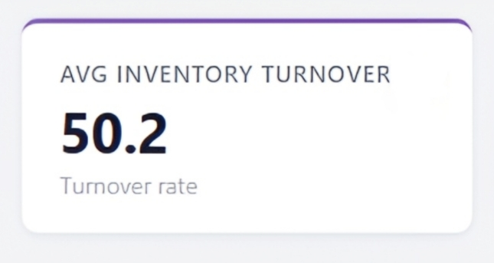
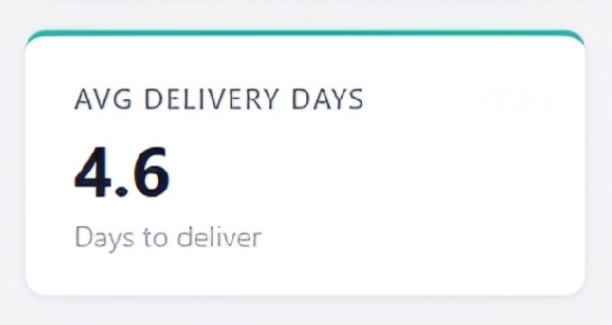
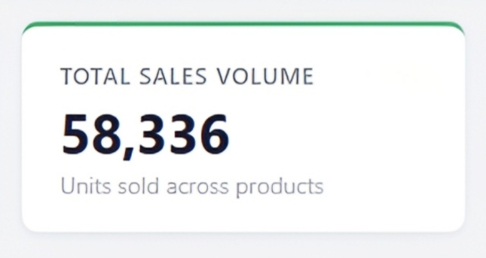
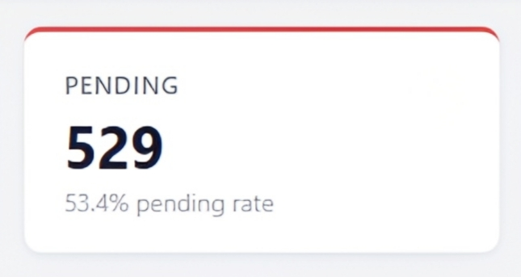
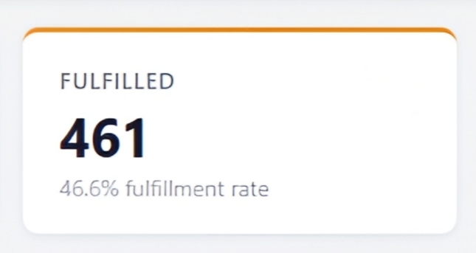
KPI’s
Inventory Turnover Rate: Fast-moving items show high turnover, indicating efficient sales, whereas slow-moving stock may need attention.
Delivery Days: Delivery timelines are consistent, though delays in some cases may impact inventory availability.
Sales Volume: Sales are strong for high-demand products, while a few items show comparatively lower movement.
Fulfilled/Pending Orders: High % of orders are pending which indicated inefficient inventory management.
Status: Overall inventory status is balanced, with a few products requiring immediate attention.

Slide 9
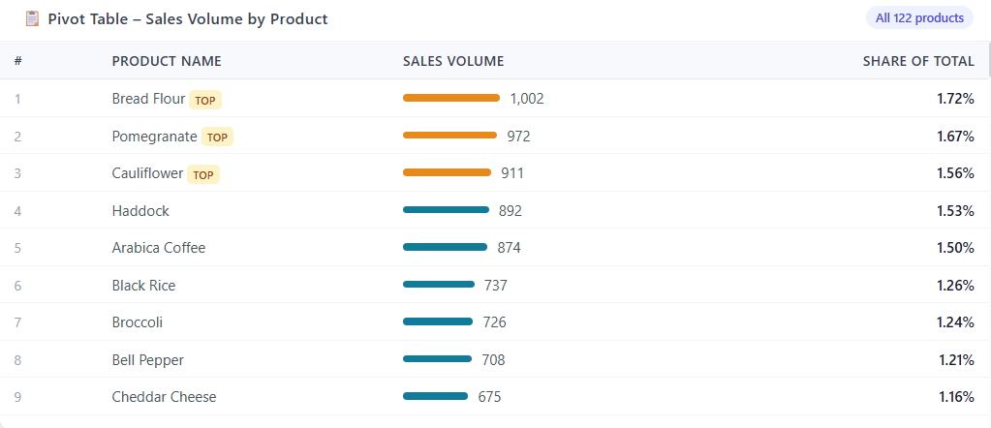
Pivot Table

Slide 10

Conclusion
All 7 project objectives achieved. Excel — with formula logic, pivot tables, and a KPI sheet — extracted meaningful business intelligence from 990 rows across 7 categories. Over half of orders are pending; 465 products need reorder; Fruits & Vegetables leads with 33% of total sales. The KPI framework (turnover, fulfilment rate, delivery time) is adaptable to any inventory dataset. AI integration cut documentation time by ~60-70%.
CONCLUSION

Slide 11

Future Scope
Build an interactive Excel dashboard with slicers, charts, and conditional formatting for non-technical users.
Integrate real-time data feeds via Power Automate or API connections.
Apply forecasting models (moving average, exponential smoothing) to predict reorder points.
Migrate analysis to Power BI for advanced visualization and geo-mapping of warehouse locations.
Fix the Status column typo (‘Reoeder required’ → ‘Reorder required’) and build a data quality audit checklist.
Expand the dataset to include supplier lead times, purchase order data, and delivery confirmations for end-to-end supply chain analysis.

Slide 12
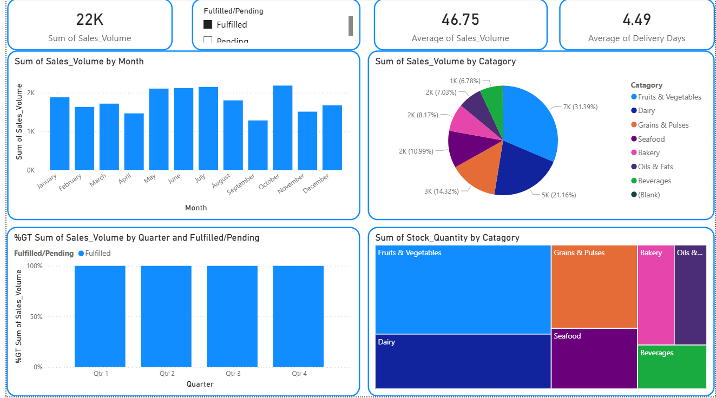
Power BI Dashboard

Slide 13
Thank You
AICW Fellowship | Student Project Presentation 2026
LinkedIn | Edunet Foundation

Slide 14
Video of Project Demo
[Paste your YouTube / Google Drive / OneDrive video link here]
▶
Insert Excel KPI dashboard and pivot table walkthrough video.
You can embed a video your live project.]

